Slide 1
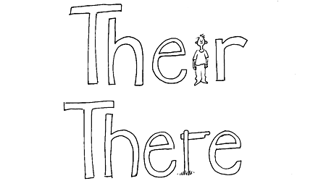
Cued Spelling

Slide 2

overview
What is Cued Spelling?
What is the underpinning psychology?
How effective is it?
Future research / Implications for practice

Slide 3

What is it?
“A user friendly and durable procedure designed to facilitate individualised, self-managed learning of spelling skills.”
(Topping, 1995)

Slide 4

Underpinning psychology

Slide 5

1. Peer tutoring
Distinctive form of peer-assisted learning.
Informed by Vygotsky’s (1978) theory of
cognitive development.
Paired Reading (Topping, 1987).
Empirical evidence of academic and affective benefits for tutors and tutees.
Recent meta-analysis identified 7 key program features for optimal effectiveness (Leung, 2014).

Slide 6
2. The learning hierarchy
Adaptation
Generalisation
Maintenance
Fluency
Acquisition

Slide 7
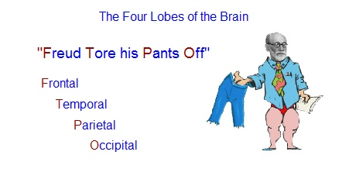
3. Elaborative rehearsal
www.theoriesofmind.com

Slide 8

4. Meta-cognition
Individuals’ own awareness of their cognitive process and strategies.
Developing an awareness of when something new has been learned.
Though choosing and verbally articulating their cues, learners are developing an awareness of their strategies.
Self-checking facilitates self-monitoring and evaluation of cues.

Slide 9
5. motivation
Self-determination theory
Competence
Autonomy
Relatedness
Ryan and Deci (2000)

Slide 10

How effective is it?

Slide 11
Empirical research
Emerson (1988); Scoble (1988, 1989)
Early descriptive research conducted with adult literacy learners.
Brierley et al. (1989)
Increase in spelling age of 0.65 years.
Average mastery review scores = 80%.
84% of children felt happier about spelling, 85% felt better able to self-correct.
Oxley and Topping (1990)
Improvements in spelling self-concept for tutors and tutees.
Ratio gains of 2.26 (tutees), 2.78 (tutors) and 3.30 (controls).
France et al. (1993)
Parent tutored approach.
Showed gains of 2.8 times the rate of a comparison group.
Watt and Topping (1993)
Average mastery review scores = 93%.
Reported a reduction in spelling errors and specific improvements in free writing.

Slide 12

evaluation
✓ Improved spelling self-concept.
Beneficial for both tutors and tutees.
Strong theoretical basis.
X Improvement in children’s spelling skills is unclear.
X Research is outdated and limited.
X Inappropriate standardised spelling tests.
X Inappropriate comparison groups.

Slide 13
Future research
Appropriate comparison groups.
Comparison of Cued Spelling with an alternative approach.
Follow up studies.
Staff/parent perceptions of children’s spelling confidence/skills.
Evaluation of children’s spelling within their free writing.
Measure of self-correction error rates.
Evaluation of number of errors.

Slide 14
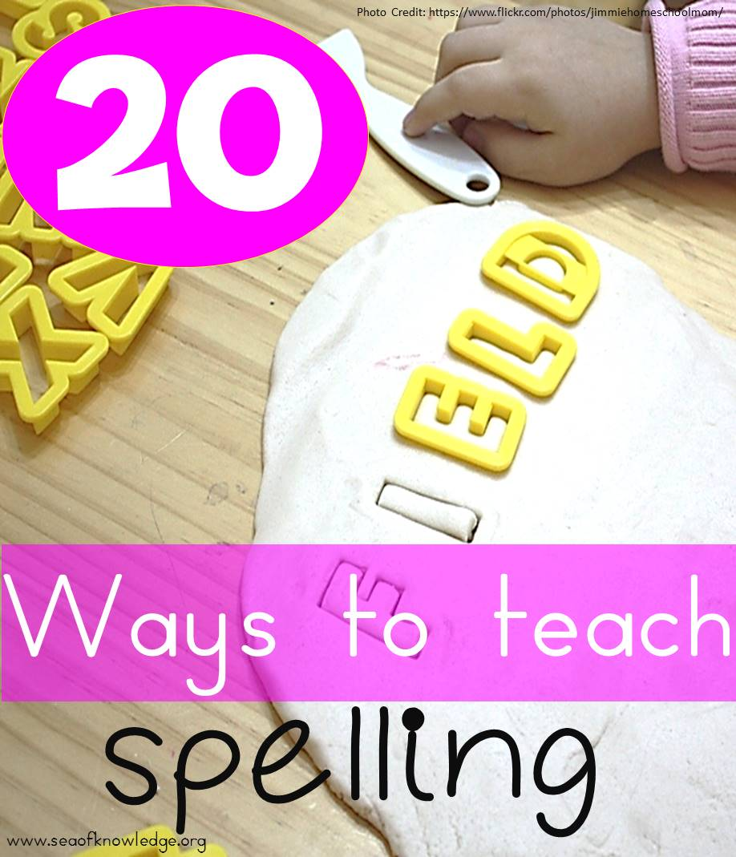
Implications for practice
A possible whole-class approach?
Fidelity to the intervention.
The importance of self-efficacy.

Slide 15

Any questions?

